Slide 1

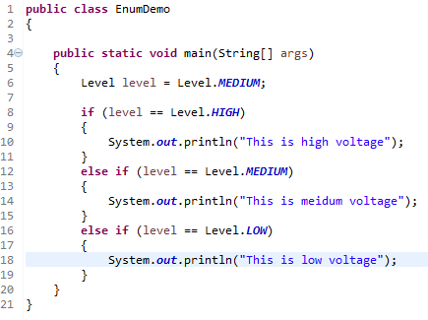
Java Enum
Since Java enums are constants you will often have to compare a variable pointing to an enum constant against the possible constants in the enum type. Here is an example of using a Java enum in an if-statement.
This code compares the level variable against each of the possible enum constants in the Level enum.

